Slide 1
MOTIVATION AND COACHING SKILLS

Slide 2
MOTIVATION
The processes that account for an individual’s intensity, direction, and persistence of effort toward attaining a goal.
KEY ELEMENTS
1. Intensity: how hard a person tries
2. Direction: toward beneficial goal
3. Persistence: how long a person tries

Slide 3
COACHING
Coaching is task oriented.
The focus is on concrete issues, such as managing more effectively, speaking more articulately, and learning how to think strategically. This requires a content expert (coach) who is capable of teaching the coachee how to develop these skills.
Mentoring is relationship oriented.
It seeks to provide a safe environment where the mentoree shares whatever issues affect his or her professional and personal success. Although specific learning goals or competencies may be used as a basis for creating the relationship, its focus goes beyond these areas to include things, such as work/life balance, self-confidence, self-perception, and how the personal influences the professional.

Slide 4
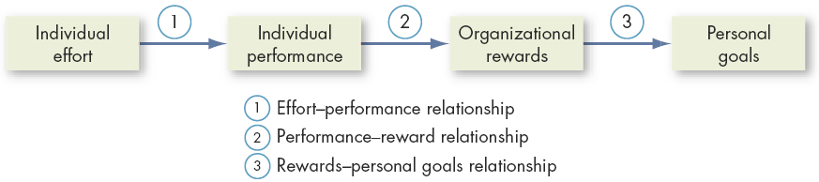
EXPECTANCY THEORY- VICTOR VROOM
The expectancy theory of motivation is based on the premise that the amount of effort people expend depends on how much reward they expect to get in return.

Slide 5
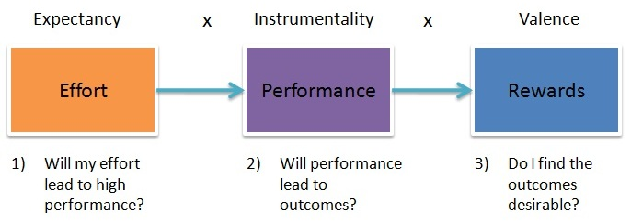
Basic Components
The following are the basic components of expectancy theory:
Expectancy
Instrumentality
Valence.

Slide 6
1. Expectancy component
An individual’s assessment of the probability that effort will lead to correct performance of the task is referred to as expectancy.
Also known as Effort- to- performance Expectancy.
Question: “if I put in all this work, will I really get job done properly?”

Slide 7
EXPECTANCY RANGE
Expectancies range from 0-1.
Where 0 is no expectation of performing the tasks correctly,
1 signifies absolute faith in being able to perform the task properly.
Self confident people have higher expectancies than less self confident people.
Being well trained increases a person’s subjective sense that he can perform the task.

Slide 8
2. Instrumentality
An individual’s assessment of the probability that performance will lead to certain outcomes is referred to as INSTRUMENTAL.
Also known as a Performance-to-Outcome expectancy.

Slide 9
Instrumental Range
Instrumentalities range from 0-1.
Where 0 means no chance of receiving the desired reward.
1 is the belief that the reward is certain to follow.
“I know for sure that if I work overtime, I will receive overtime pay.”

Slide 10
3. Valence
The worth or attractiveness of an outcome is referred to as valence.

Slide 11
Valencies Range
From -100 to +100 or -1 to +1.
+100 means that the person intensely desires an outcome.
-100 means that the person is strongly motivated to avoid an outcome.
Valence at 0 means indifference to an outcome.

Slide 12
LEADERSHIP SKILLS AND BEHAVIOUR ASSOCIATED WITH EXPECTANCY THEORY
Determining what levels and kinds of performance are needed to achieve organisational goals.
Make the performance level attainable by the individual being motivated.
Train and encourage people.
Make explicit the link between rewards and performance.
Make sure the rewards are large enough.
Understand individual differences in valence.

Slide 13
GOAL THEORY- Edwin Locke

Slide 14
BASIC FINDINGS OF GOAL THEORY
A GOAL is what a person is trying to accomplish.
Goals set should be the difficult one. WHY?
For example:
A leader who values honesty will establish a goal of hiring only honest employees.
This leader has to make extensive use of reference checks and honesty testing.

Slide 15
Leader should keep following points in mind while motivating people through goal setting…
Specific goal lead to higher performance than do generalized goal.
Performance generally improves in direct proportion to goal difficulty.
For goals to improve performance, the group member must accept them.
Goals are more effective when they are used to evaluate performance.
Goals should be linked to feedback and rewards.
Group goal setting is as important as individual goal setting.

Slide 16
COACHING SKILLS AND TECHNIQUES
Communicate clear expectations/ goals to group members.
Build relationship.
Give feedback on areas that require specific improvement.
Listen actively.
Help remove obstacles.
Give emotional support.
Give some gentle advice and guidance.
Allow for modeling of desired performance and behaviour.
Gain a commitment to change.
Applaud good result.

Slide 17
EXECUTIVE COACHING
An executive coach is an outside or inside specialist who advises a person about personal improvement and behavioural change.
A major role of the coach is to give the leader an impartial perspective and help brainstorm solutions to problems.
Executive coaches provide such a variety of services that they have been described as combination of “a counselor, advisor, mentor, cheerleader and best friend.”

Slide 18
EXECUTIVE COACHING AND LEADERSHIP EFFECTIVENESS
Executive coaches help managers become more effective leaders by helping them in ways such as the following:
Counseling the leader about weaknesses that could interfere with effectiveness, such as being too hostile and impatient.
360 degree surveys.
Serving as a sounding board when the leader faces a complex decision about strategy, operations or human resources issues.

Slide 19


Slide 20

Creativity- Meaning
Creativity is a phenomenon whereby something new and valuable is formed.

Slide 21
ORGANISATIONAL METHODS TO ENHANCE CREATIVITY
Systematically collecting fresh ideas
Brainstorming (Emails or Group discussions)
Using Pet Peeve Technique (Brainstorming in which group identifies all possible complaints other’s might have about the organisation as a unit)
Equipping kitchen for the mind and creativity.

Slide 22

CREATIVITY PROCESS
Opportunity or Problem recognition
Immersion (Totally immersed/ considering)
Incubation (Not working on it actively but sub-conciously)
Insight
Verification and application

Slide 23
CHARACTERISTICS OF CREATIVE LEADERS
KNOWLEDGE
- Knowledgeable about wide range of information.
2. INTELLECTUAL ABILITIES
- Highly Intelligent
- Intellectually curious
- Able to think divergently
PASSION FOR THE TASK AND FLOW
PERSONALITY
- Self confident
- Thrill seeking (person who is keen to take part in exciting activities that involve physical risk)
- Energetic

Slide 24
TASK
Find some creative work and discuss with class.

Slide 25
Conflict and Negotiation

Slide 26
Conflict
Conflict Defined
  A process that begins when one party perceives that another party has negatively affected, or is about to negatively affect by something that the first party cares about.

Slide 27

Transitions in Conflict Thought
Traditional View of Conflict
The belief that all conflict is harmful and must be avoided
Causes
Poor communication
Lack of openness
Failure to respond to employee needs

Slide 28
Transitions in Conflict Thought (cont’d)
Interactionist View of Conflict
The belief that conflict is not only a positive force in a group but that it is absolutely necessary for a group to perform effectively.

Slide 29
Functional versus Dysfunctional Conflict
(Positive)
NOT ALL CONFLICTS ARE GOOD.
Functional Conflict
Conflict that supports the goals of the group and improves its performance.
Dysfunctional Conflict
Conflict that hinders group performance
(Negative)

Slide 30
Types of Conflict
Task Conflict
Conflicts over content and goals of the work
Relationship Conflict
Conflict based on interpersonal relationships
Process Conflict
Conflict over how work gets done

Slide 31
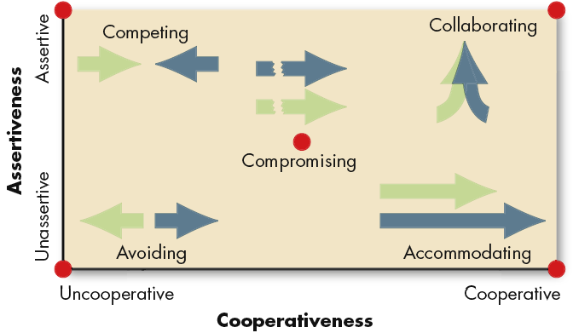
How can a leader handle Conflicts
Source: K. Thomas, “Conflict and Negotiation Processes in Organizations,” in M.D. Dunnette and L.M. Hough (eds.), Handbook of Industrial and Organizational Psychology, 2nd ed., vol. 3 (Palo Alto, CA: Consulting Psychologists Press, 1992), p. 668. With permission.
E X H I B I T 15-2

Slide 32
Conti..
Competing
A desire to satisfy one’s interests, regardless of the impact on the other party to the conflict
Collaborating
A situation in which the parties to a conflict each desire to satisfy fully the concerns of all parties.
Avoiding
The desire to withdraw from or suppress a conflict

Slide 33

Accommodating
The willingness of one party in a conflict to place the opponent’s interests above his or her own.
Compromising
A situation in which each party to a conflict is willing to give up something.

